Slide 1
Performance Management Training for Managers

Slide 2

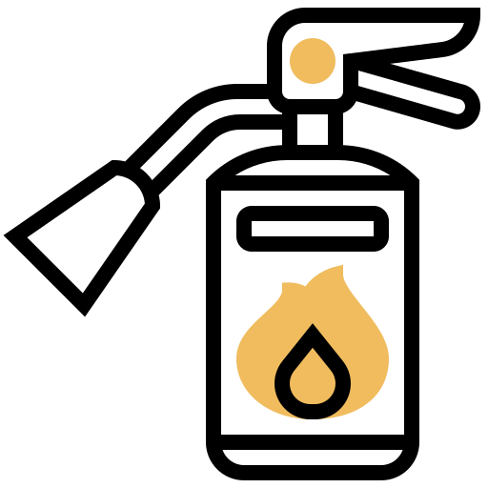




SAFETY BRIEFING
Toilets
Fire Extinguishers
Defibrillator
Smoking
Assembly Areas
‘Be Present’ - Safety Share
Seek, Share, Listen, Champion
Notes:
Garry introduction to the P and C team

Slide 3
Purpose
The purpose of the performance management training is to ensure that managers are equipped with the tools to manage poor performance, to recognise when performance concerns need to be addressed and measures are put in place before it becomes a formal performance process.
Early intervention is key.

Slide 4
Reason
We currently have team members across the business that are not performing to our expectations.
Specifically, based on the recent performance appraisal process we have a number of technical team members that are not performing to the required levels of performance.
We want to help shift the business to a high performance culture.
Currently not all managers know how to deal with performance issues and therefore poor performance is not being dealt with effectively.
Notes:
51 technicians achieved a rating of 2 during the year end appraisal process. Albeit some of those employees will be new to the business.
Expectation is to shift the business to a high performance culture and for those individuals to shift their performance to achieve a 3 which is consistent performance.
For those individuals that don’t make it to that level, there is a requirement to performance management them and deal with poor performance.
There will be a requirement for managers to lead this process with support from the P and C team. This means that managers will need to ensure that evidence is up to date and that employees are being measured and assessed correctly

Slide 5
TERRA CAT
There is a direct correlation between ratings and skill with both below expected standards.
How can Terra charge $115 for below expectation.

Slide 6
Outcome
Managers will have the tools to recognise poor performance and understand the process to deal with performance concerns.
Team members will have the opportunity to turn their performance around and meet expectations.

Slide 7
What is performance management?
“Performance management is the process of creating a work environment, or setting, in which people are enabled to perform to the best of their abilities. Performance management is an ongoing process that begins when a job is defined as needed and ends when an employee leaves your organisation”
Notes:
I like this statement as it reflects performance management is for the entire employee lifecycle and is all aspects of performance. Poor performance is the negative aspect of this.
7

Slide 8
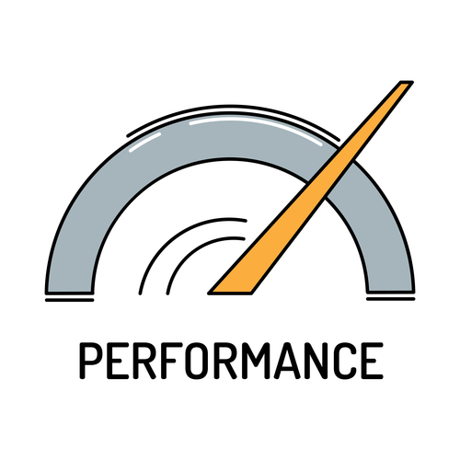
Managing Poor Performance
What does poor performance look like in your team?
What impact does poor performance have on your team and yourself if you don’t address it?
What are some of the barriers or reasons we face that stop us from properly addressing poor performance?
Notes:
Using a whiteboard or flip chart ask the audience for feedback on what they think poor performance looks like?
What impact does it have it you don’t address it? and
What are some of the reasons/ barriers that stop us addressing poor performance?
Before going to the next slide also ask
What are the common reasons for poor performance?
Also put this on the white board.

Slide 9

What are the Common Reasons for Poor Performance?
Don’t know job responsibilities
Don’t know how to do their job
Have the wrong priorities
Afraid to ask questions
No positive reinforcement
No feedback or consequences
Conflict with other staff members
Personal limits
Not interested in the job
Notes:
Before you go to the next slide ask the audience what is the difference between poor performance and misconduct. 2mins

Slide 10
Performance Management vs Misconduct
Poor Performance | Misconduct | Serious Misconduct
Not meeting requirements of position | Behaviours inconsistent with workplace e.g. offensive language | Failing to obey a lawful and reasonable instruction
Low productivity | Excessive lateness/ absenteeism | Conduct that causes /may cause risk to the health or safety of a person, or to the business
Low quality of work | Treating colleagues or customers disrespectfully | Bullying, sexual or any kind of harassment; verbal or physical abuse

Slide 11
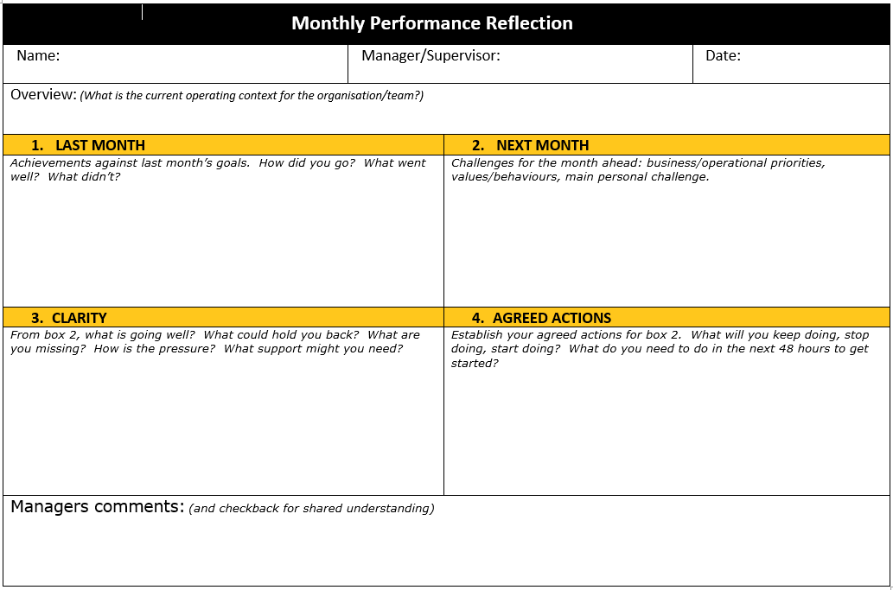
Concerns with employee’s performance
There are two options…
1. Review and update the Monthly Performance Reflection (MPR)
The MPR can be used for all areas of performance. It enables you to work with your employee to identify competencies that need to be developed
Accountability is with the employee to shift performance
No disciplinary outcomes
If no uplift in performance - formal Performance Management Plan (PMP)
-
Notes:
Provide handout
If there is continued performance issues that have not improved you can use the MPR to address the gaps.
If the employee continues to fail to improve then you would work with P and C to progress to a performance management plan
You will need to ensure in the MPR that you have informed the employee of the potential consequences if they do not meet the requirements of the MPR for that month
There will be training on MPR’s as part of the Frontline leadership training the beginning of August

Slide 12
Employees performance has not shifted
2. Performance Improvement Plan (PMP)
Formal Improvement Program delivered in conjunction with P and C to uplift person’s performance.
Transparent process.
Shortcomings are clearly communicated to employee.
Adequate notice of consequences for failure to improve.
Generally a 3 month process, objectives are set at:
4 weeks - failure to improve – provide written warning
8 weeks - failure to uplift performance – provide final warning
12 weeks - if no sustained uplift in performance, employee’s ongoing employment is reviewed. Outcome may be termination.
Notes:
Provide Handout
P and C will support you with the process it take 3 months (4 including the MPR) to go through a plan and if the employee fails to meet the requirements at each stage or month then disciplinary action is taken potentially through to termination.
It is a very lengthy process where you would be requirement to meet with the employee each week to measure performance against the action plan and working with P and C to review each month whether the employee has met the requirements.
Once again you will lead this process.

Slide 13
What Process to Take?
Manager becomes aware of performance shortfall.
Issues raised with employee when they occur. Potential consequences of non improvement clearly stated in next MPR.
Where performance has not improved discuss with People and Culture.
People and Culture prepare invitation to formal meeting.
Manager provides to team member.
Hold formal meeting.
People and Culture write outcome letter and Performance Management Plan which details subsequent meetings.
Manager prepares for each review meeting with People and Culture.
Hold review meeting.
People and Culture write letter outlining outcome of meeting. Where performance does not improve the potential sequence of outcomes could be
1. Performance Management Plan
2. Written warning
3. Final written warning
4. Dismissal

Slide 14
Support Tools
PMP Template
Letters
File notes
Notes:
Provide handouts

Slide 15
The Importance of File Noting
Always take a file note
A record of performance observations.
It is your record of a meeting with your direct report.
Request a simple template from HR
Type in Word or simply write on paper.
Email to yourself – or send a copy to HR if you feel the issue might progress, or it does progress (make sure to delete email).
What is a file note?
Date & time of discussion
Content of discussion
Performance concern raised – specific details
The employees response
The standard set
The agreed actions/
timelines & follow up date
Any other important details
What format can the file note be in?

Slide 16


File Notes
06/07/20 3.00p.m.
Had a discussion with John today about the amount of mistakes he is making and redo that is occurring.
Three times now it has taken John an hour longer than scheduled to complete the repairs on the wheel loader. He has also made mistakes with the mini excavator we are currently repairing for an important customer. We reviewed the standards required and John’s previous training and he stated that he is not confident completing the repairs.
We agreed that John needs to become more efficient in the repairs that he is doing, complete the repairs on time and with no mistakes.
As a qualified mechanic John should be operating at a higher lever. I agreed to provide John with additional training and revision to ensure he is up to speed.
John is committed to learning how to use the tools correctly, and complete the repairs in the allotted time with no mistakes and a review is taking place in four weeks.
John makes too many mistakes and this has caused a lot of redo’s at the branch. He agreed to try harder.

Slide 17
Summary
Early intervention is key
Performance management is an ongoing process
If performance is not addressed it can impact the rest of the team
There are many reasons for poor performance
Performance differs from misconduct, and we need to understand the differences
Use the MPR to deal with performance concerns before it becomes performance management
The P and C team will provide you with the tools to deal with poor performance but this is manager lead

Slide 18
Questions?

